Slide 1
Microsoft Remote Build Execution Dev Speedup with Non-Hermetic Build Engines
AnyBuild
Erik Mavrinac
Microsoft One Engineering System
November 20, 2019

Slide 2
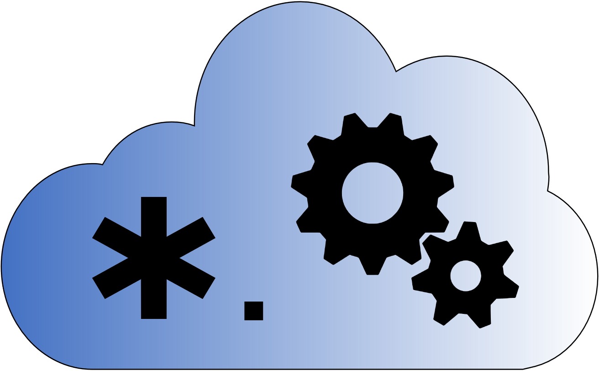
Talk Overview
Background, motivation & challenges
The AnyBuild approach
First results
Internals
Roadmap

Slide 3
Microsoft Cloud Based Build
CloudBuild and QuickBuild – 2012
Allow distributing MSBuild and the 1989 NT nmake build system
E.g.: 10-hour retail builds ➔ ~1 hour, 6-hour debug builds ➔ ~16 minutes
Caching came later to make 1-minute builds common
Build Accelerator (BuildXL) – 2014
Cache-first, based on Bazel pattern of complete input, output specs
Windows and Office first – the largest codebases in the company at 250-500 GB
Open source in early 2019, MSBuild support in 2018, converging with QuickBuild slowly
CloudBuild builds thousands of repos from a few megs to ½ TB
400K builds/week on >35,000 physical machines

Slide 4
The Basic Premise of Remote Execution
RE extends a build machine’s capabilities
More CPU cores (and GPUs if that’s your need)
More memory
Most importantly: More I/O buses and disks
Most conventional build tools are I/O-heavy
Has costs in terms of cloud compute, latency and overhead per remoted task moving data back and forth
Trade compute cost for overall developer time and productivity
Example from one 75-person internal team: Reduction by half of build time on longer desktop builds can save 9500 hours/month
Plus reduces or delays the need for devs to spend time optimizing build logic
Maybe reduce dev desktop SKU and make laptops more viable

Slide 5
The AnyBuild Approach
Notes:
What if…
- We let an existing build engine just do whatever it wants to do locally with filesystem timestamp or hash based incrementality etc. (build language and build tool nondeterminism problems)
- We watch what it decides to do and remote things selectively
- And we can remote on minimal agents that don’t need to have enlistments, packages, or Ʃ(tools) installed (agent tool and enlistment problems)
- And we ensure that tools that rely on absolute paths still work seamlessly (path reliance problem)
- And we run on dev desktops, letting the cloud extend the dev machine (augmenting batch build pattern in dev workflow)

Slide 6
Microsoft AnyBuild Remote Execution
Client wraps existing engine, hooks process creation
Choose to remote based on current machine state, policies, historical knowledge, agent availability
Client and Agent CAS are central to system similar to Bazel RE
Same upload/download gRPC protocol, see later slide
Agents are minimal Win10 1903+ images with no toolsets installed
Filesystem virtualization: Tools see client paths, no difference from running at client
New vs. Bazel RE: Agent can reach back to client to pull missing directories and files dynamically, non-hermetic predictions are slower instead of failing

Slide 7
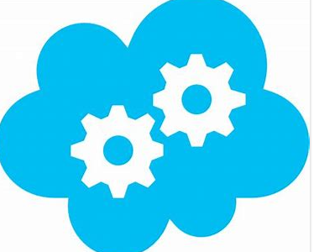



High Level How-Does-It-Work?
Dev Desktop/Laptop
Remote Build Execution Service
Remote Build Execution client
Lives within regular build command
Integrated update mechanism
Agent Coordinator intelligently allocates VMs (number + size) to optimize build time & distributes build tasks among VMs
3. Copy delta of files to build in cloud
VMs run the required build tasks in parallel, leveraging peer-to-peer CAS
1. Dev initiates local build command (the same they normally use)
2. Remote Build Execution Client analyzes which build tasks to offload
4. Copy offloaded build outputs
CAS manages the cache of previous build inputs and outputs
5. Merge build results (re-use from cache when possible)
If service is unavailable, local build works transparently

Slide 8
First Customer Results

Slide 9
Beefy desktop – up to 8 minutes saved of 18.5

Slide 10
Laptop – up to 41 of 70 minutes saved

Slide 11
Details
6/12 core: Desktop dev machine, 64GB mem, M.2 SSD
2/4 core: Laptop, 16GB mem, SSD
Internal C++-heavy mid-sized repo
500 MSBuild projects, 300 vcxproj (C++)
19 build agents plus service coordinator VMs in shared 100-core team deployment with from 2 to 32 cores per agent
Azure D2 v2 generic compute VMs preferred for agents
v3 would be less expensive per core but less capable, temp drive is too small on 2-core SKU
Deployment would cost ~$2.5K/month in VM time when using dynamic sizing and daytime business schedule
cl.exe (compiler) remoting only (like Goma)
Debug full build with no LTCG linking
MSBuild parallelism settings at +25% meaning /m:115 for the 6/12 core and /m:5 for the 2/4 core
AnyBuild MinParallelism=3 to remote only larger compilations (3+ cpp files)

Slide 12
Internals

Slide 13

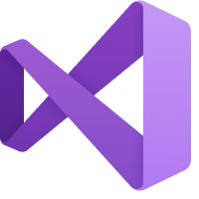

AnyBuild Agent
Visual Studio
Compiler
AnyBuild Sandbox
MSBuild
AnyBuild Agent
robocopy
VSTest
Remote Shim
exe
VSTest
Remote Shim
exe
Compiler
Local Disk
Notes:
Narrator: Let’s say you’re using Visual Studio for your project. <tap>
You’ve installed Microsoft AnyBuild and you hit F6 to build and test. <tap>
You are using MSBuild as your build language. <tap>
We wrap MSBuild in an AnyBuild execution sandbox <tap> to intercept MSBuild’s actions. MSBuild proceeds to run all of its usual tool chains<tap>, including incrementalism derived from timestamps and other information on disk.
Let’s say MSBuild decides to run an external process <tap> like a compiler.
AnyBuild sees this action and inserts <tap> a proxy process. The command line, environment, and current working directory are <tap> passed to AnyBuild.
AnyBuild predicts file and directory inputs and determines that this process is worth remoting. <tap> AnyBuild gets an available build agent from the cloud, and <tap> tells it to run your process. AnyBuild caching technology uses petabytes of cloud storage to cache every source code file, every package, and every app that your repo uses, so that we only upload the very latest files you changed on your dev machine.
<tap> We cache the outputs in the cloud, then pull them back to your dev machine, <tap> and place them on your hard drive just as though the results were run locally. Then we release MSBuild to keep processing. <tap>
When an Azure AnyBuild agent is not available, or for processes that <tap> require far more I/O than CPU power, AnyBuild can <tap> run the process locally.

Slide 14
Azure Deployment Architecture
Agents are VMs, not containers
ProjFS, BindFlt need admin
Azure VM Scale Sets make for easy scale up/down
Agents are reused between commands but are team or org specific
Agents host P2P Cache microservice for multi-layer BuildXL cache
Dynamic VM scaling based on load, mixed with static business hours scheduling
AgentCoordinator service provides agent lists to clients within shared pool
Agents currently use direct IPs, clients move on if agents are busy
Intent is to move to a centralized service proxy like RE over time
CosmosDB, Redis, Blob Storage, KeyVault underlie these pieces

Slide 15
Specialized Execution gRPC call
2-way server<->client
Stdout, stderr outputs are interleaved for higher fidelity output
Agent can reach back to client to get directory metadata, file hashes, file contents not predicted by client
This is how we handle nondeterminism and optimism failures in CAS
E.g. #include “..\inc\foo.h” not found in command prediction or other data will result in slowness but not failure
We can take specific misses and feed back to users in a UX if we know it’s something they need to add metadata about. “Your build would be faster if you added <ClInclude>..\inc\foo.h</ClInclude> to bar.vcxproj”

Slide 16
Content Addressable Store
Implementation uses the tiered local and peer-to-peer BuildXL cache system
No “backdrop” layer currently since we can always get files from client
gRPC between machines
Redis as replica tracking store
Layered metadata database state caches (“LLS”) in between
Client has a local CAS for build output caching
Only used for known-deterministic commands
Since we can call back to dynamic file retrieval from client, CAS can be best-effort optimistic within reason

Slide 17
Roadmap
Shipped internally to first customer in late October
More customers coming soon
Many more perf improvement experiments to do, will ship incrementally
BazelCon (Dec 2019) timeframe: First trivial Bazel build against Agent
Aiming to go fully open source in next few months: https://github.com/Microsoft/AnyBuild
Next year: 2-way agent contract as an RE protocol extension
Possible integrations next year: BuildXL, QuickBuild, Azure DevOps Pipelines, CloudBuild

Slide 18
Older, similar, longer version of these slides here
AnyBuild: https://github.com/Microsoft/AnyBuild
BuildXL: https://github.com/Microsoft/BuildXL
MSBuild: https://github.com/Microsoft/MSBuild
CloudBuild Whitepaper

Slide 19


